Slide 1
Integrating Concepts in Biology
PowerPoint Slides for Chapter 14:
Cells at the Population Level
by
A. Malcolm Campbell, Laurie J. Heyer, and Chris Paradise

Slide 2
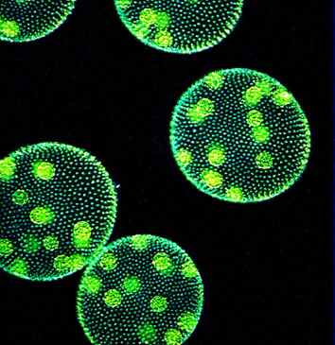
Front art piece UN14.1
Notes:
Front art piece UN14.1 Several Volvox colonies, each consisting of a population of individuals, with daughter colonies visible growing within the main green alga colony.

Slide 3
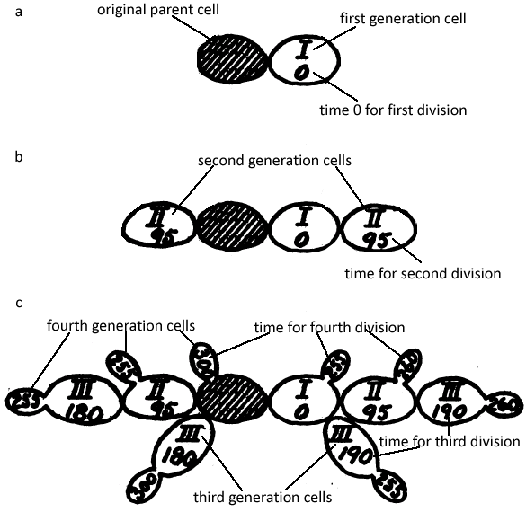
Figure 14.1
Notes:
Figure 14.1 Schematic of cell division for bacteria observed on agar plate under microscope. The shaded cell is the original parent cell; its first division yielded one offspring cell (a). The second generation is shown in (b), and third and fourth are shown in (c). Roman numerals indicate the generation and Arabic numerals number of minutes, in 5 minute increments, for the indicated cell to appear. Each cell, including the parent cell divided in each generation.

Slide 4
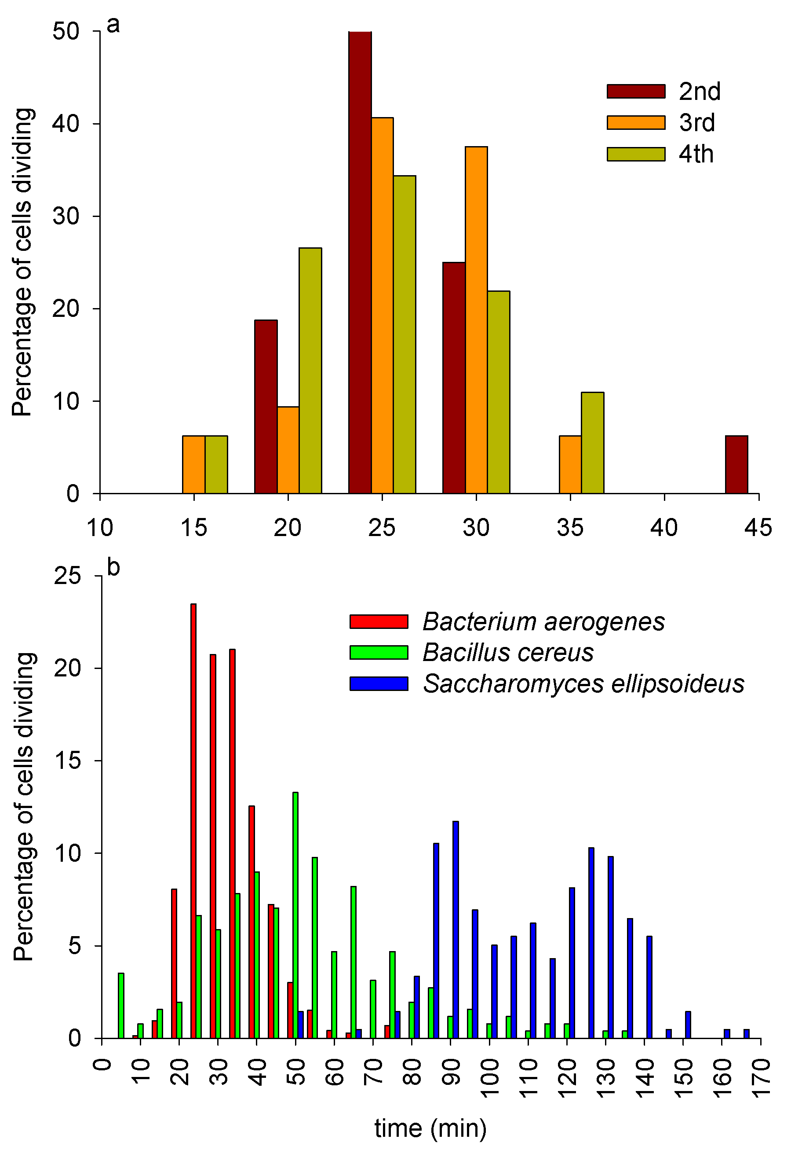
Figure 14.2
Notes:
Figure 14.2 The proportion of cells dividing within a particular period of time for (a) a single small population of Bacterium aerogenes tracked over four generations and (b) three species of bacteria, with data pooled across generation and population. In (a) 2nd, 3rd, and 4th refer to the generation.

Slide 5
Figure 14.3
Notes:
Figure 14.3 Growth curve for cultures of E. coli bacteria. Growth is expressed in absorbance of the sample at 600 nm. The average of 3 replicate cultures + 1 standard deviation is shown. The curve is an approximate best fit line. The arrows mark different phases of bacterial population growth, denoted as lag, log phase, and stationary phases.

Slide 6
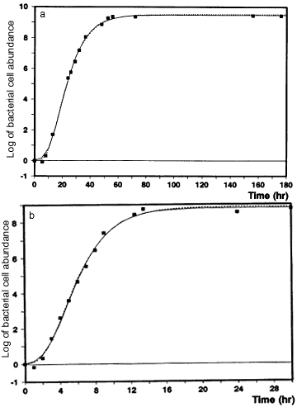
Figure 14.4
Notes:
Figure 14.4 Growth curves of L. plantarum grown at 18.2 (a) and 35ºC (b).

Slide 7
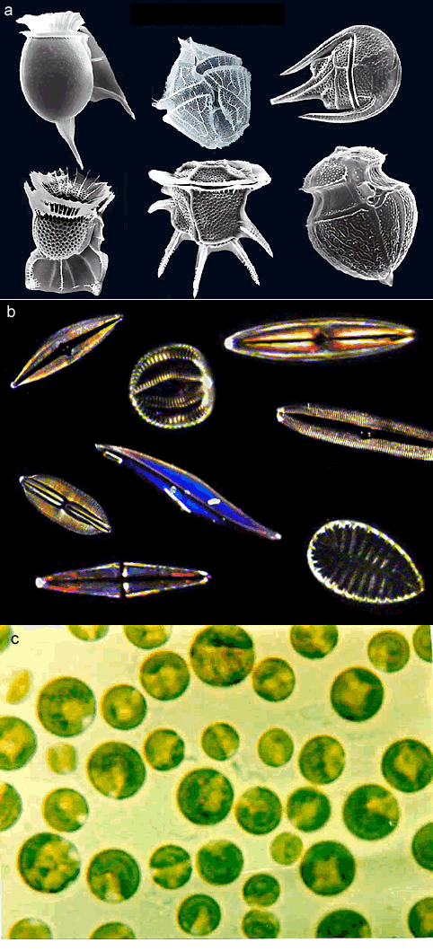
Figure 14.5
Notes:
Figure 14.5 Representative dinoflagellates (a), diatoms (b), and the green alga Chlamydomonas sp. (c).

Slide 8
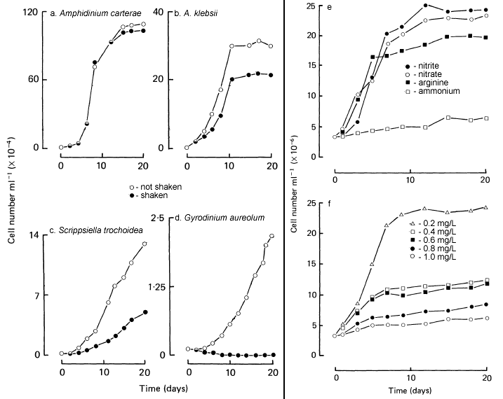
Figure 14.6
Notes:
Figure 14.6 Effects of shaking on the growth of four dinoflagellate species grown in the laboratory (a-d) and effects of nitrogen source (e) and concentration of ammonium (f) on growth of A. carterae.

Slide 9
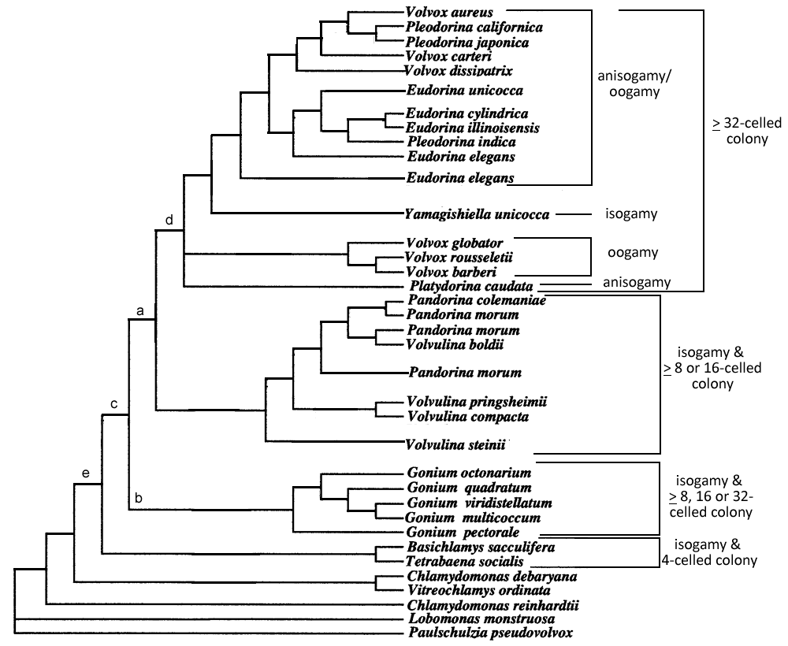
Figure 14.7
Notes:
Figure 14.7 Evolutionary tree of the Volvocaceae generated using 6,021 nucleotide bases from coding regions of five chloroplast genes. Species that appear more than once had more than one strain, or laboratory population, sampled for their DNA. Brackets and divisions to the right are described in text.

Slide 10
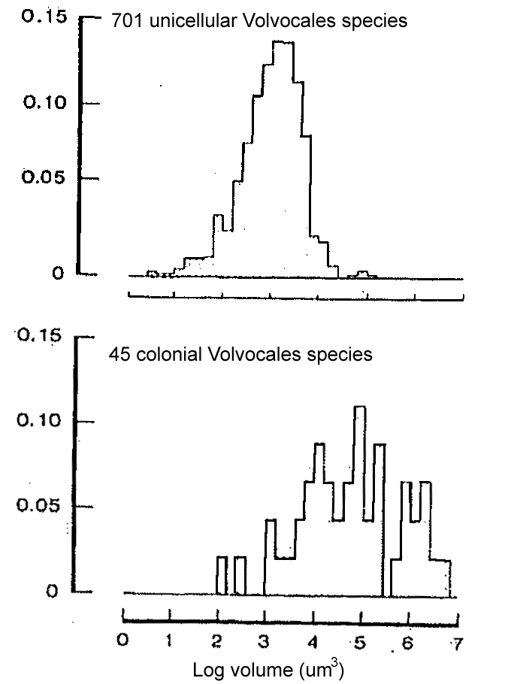
Figure 14.8
Notes:
Figure 14.8 Frequency distributions of size of cells for unicellular Volvocales and colonies for colonial Volvocales. Proportions are on the y-axis and log volume is in cubic micrometers.

Slide 11
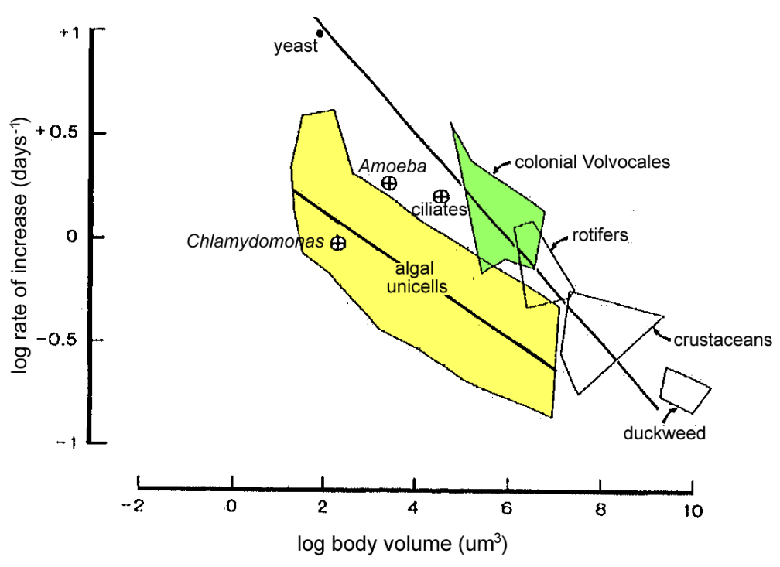
Figure 14.9
Notes:
Figure 14.9 Population growth rates of increase in relation to organism size. The two straight lines represent best fit lines for unicellular algae (lower line in the yellow area) and all other organisms (upper line). The thinner lines bound data points for the indicated groups of species, with colonial Volvocales within the green area and unicellular algae in the yellow area. Means for three selected groups are shown as circled plus signs.

Slide 12
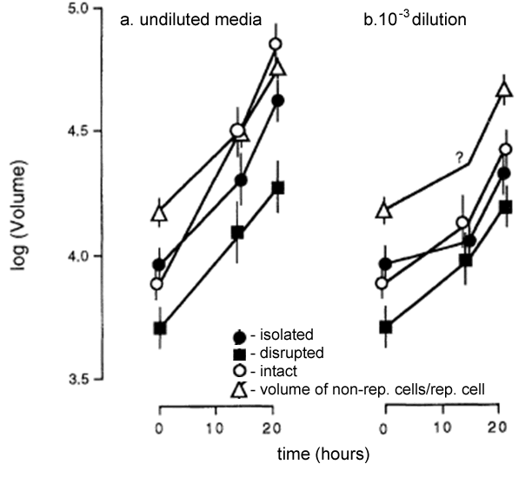
Figure 14.10
Notes:
Figure 14.10 Growth of reproductive cells in V. carteri. The means + 2 standard errors are shown for the two replicates in each condition. Data are shown for the highest nutrient concentration (a) and the lowest concentration (b). Volumes of non-reproductive cells per reproductive cell are also shown. The question mark represents an estimated point.

Slide 13
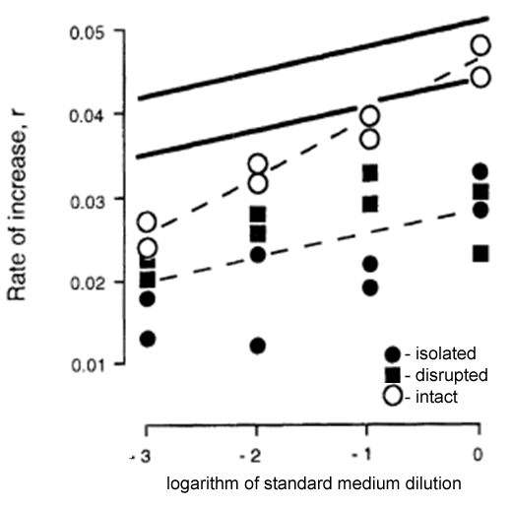
Figure 14.11
Notes:
Figure 14.11 Growth rates of reproductive cells, relative to initial volume, in V. carteri across four concentrations of growth media. Solid lines describe the range of growth rates that would make division of labor advantageous (see text), and dashed lines are best fit lines for intact colonies (upper) and for combined isolated cells and cells from semi-disrupted colonies (lower).

Slide 14
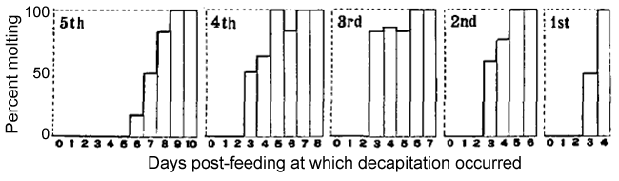
Figure 14.12
Notes:
Figure 14.12 The proportion of R. prolixus that molted in each instar after being decapitated on different days post-feeding. Molting occurred days to weeks after the decapitation.

Slide 15
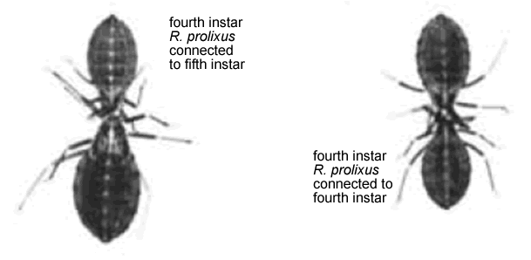
Figure 14.13
Notes:
Figure 14.13 Decapitated R. prolixus bugs attached to each other.

Slide 16
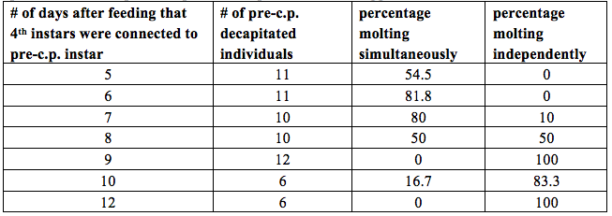
Table 14.1 Molting of fourth or fifth instar R. prolixus individuals that were decapitated 24 hours after feeding and then connected to another decapitated fourth instar individual that had passed the critical period. c.p. = critical period.
Table 14.1
Notes:
Table 14.1 Molting of fourth or fifth instar R. prolixus individuals that were decapitated 24 hours after feeding and then connected to another decapitated fourth instar individual that had passed the critical period. c.p. = critical period. From Wigglesworth 1934.

Slide 17
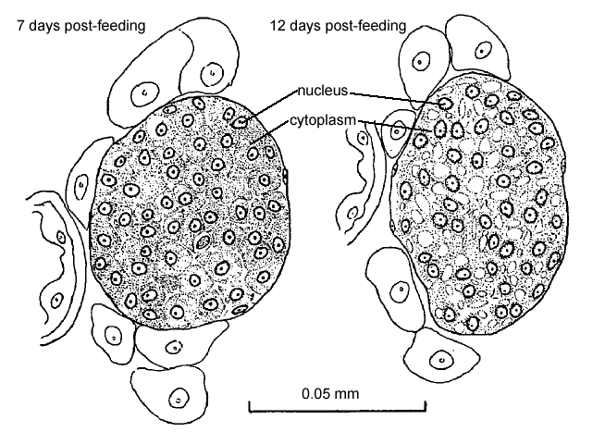
Figure 14.14
Notes:
Figure 14.14 Cross sections of the corpus allatum in R. prolixus fifth instar individuals taken at two different days after feeding.

Slide 18
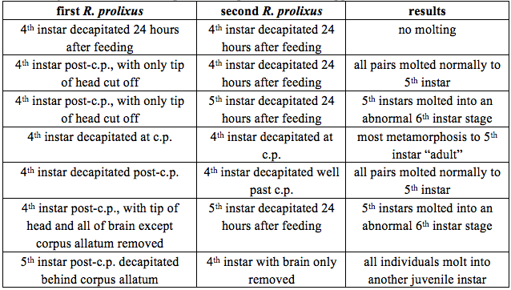
Table 14.2 Decapitation experiments of R. prolixus individuals to determine the source and action of juvenile hormone. C.p. = critical period.
Table14.2
Notes:
Table 14.2 Decapitation experiments of R. prolixus individuals to determine the source and action of juvenile hormone. C.p. = critical period. From Wigglesworth 1934.

Slide 19
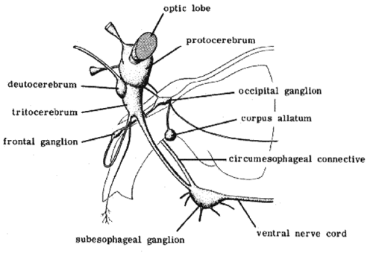
Figure 14.15
Notes:
Figure 14.15 Lateral view of a typical insect brain. The unshaded regions are other parts of the body, including the esophagus, which the circumesophageal connective, part

Slide 20
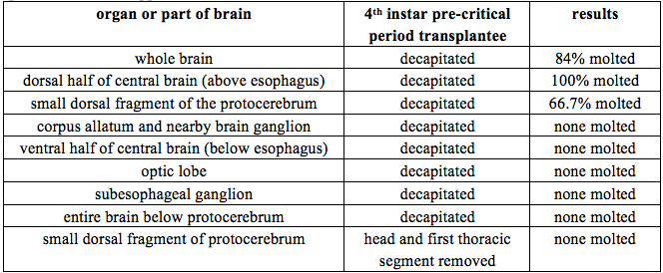
Table 14.3 Brain transplant experiments of R. prolixus individuals to determine the source of molting hormone. In each experiment, the indicated organ or part of the brain was transplanted from a post-critical period R. prolixus and transplanted to a 4th instar pre-critical period R. prolixus.
Table14.3
Notes:
Table 14.3 Brain transplant experiments of R. prolixus individuals to determine the source of molting hormone. In each experiment, the indicated organ or part of the brain was transplanted from a post-critical period R. prolixus and transplanted to a 4th instar pre-critical period R. prolixus. From Wigglesworth 1940.

Slide 21
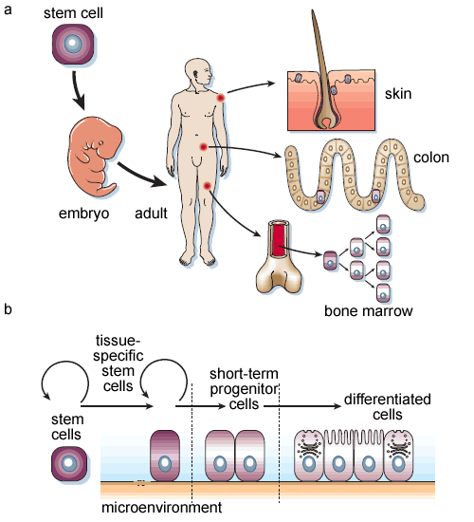
Figure 14.16
Notes:
Figure 14.16 Development of stem cells. a. stem cells are involved in embryonic and adult cell growth and differentiation. b. Stem cells give rise to tissue-specific stem cells, depending upon micro-environmental conditions. These give rise to progenitor cells, which mature into differentiated cells.

Slide 22
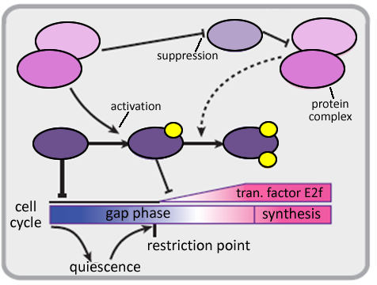
Figure 14.17
Notes:
Figure 14.17 Partial schematic cartoon of cell cycle regulation in adult stem cells. Different proteins are indicated by different colored ovals and yellow circles are phosphate ions. The bar at the bottom represents phases of the cell cycle.

Slide 23
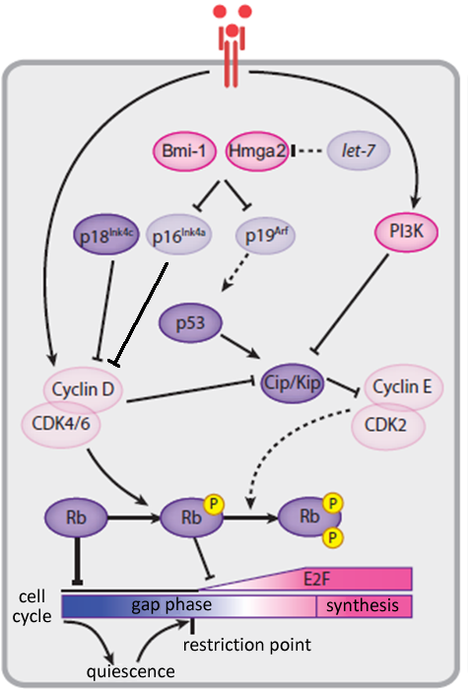
Figure 14.18
Notes:
Figure 14.18 Cell cycle regulation in adult stem cells. More intensely shaded ovals indicate gene products that are functionally important while ovals with less intense color are less expressed or active. The bar at the bottom represents phases of the cell cycle, and the letter “P” denotes phosphorylation.

Slide 24
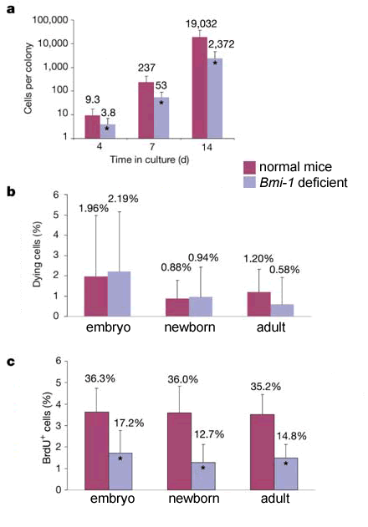
Figure 14.19
Notes:
Figure 14.19 Effects of loss of Bmi-1 on stem cell colony proliferation (a), cell death (b) and BrdU incorporation (c). In (a) CNS stem cells from newborn mice were dissociated and plated in cultures, and the number of cells per colony was counted after 4, 7 and 14 d. * indicates that the Bmi-1 deficient mouse stem cells had a statistically different response from normal mice.

Slide 25
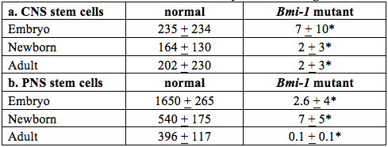
Table 14.4 Effect of loss of Bmi-1 on self-renewal of CNS and PNS stem cells. Stem cells originated in embryos, newborns, or adults and were grown for 10 days in culture. (a) CNS stem cells. (b) PNS stem cells. Values are the mean number of new cells formed + 1 s.d. for 3–6 independent experiments. * indicates that the Bmi-1 deficient values were significantly different from those obtained from normal mice.
Table14.4
Notes:
Table 14.4 Effect of loss of Bmi-1 on self-renewal of CNS and PNS stem cells. Stem cells originated in embryos, newborns, or adults and were grown for 10 days in culture. (a) CNS stem cells. (b) PNS stem cells. Values are the mean number of new cells formed + 1 s.d. for 3–6 independent experiments. * indicates that the Bmi-1 deficient values were significantly different from those obtained from normal mice. From Molofsky et al. 2003 Figure 1.

Slide 26
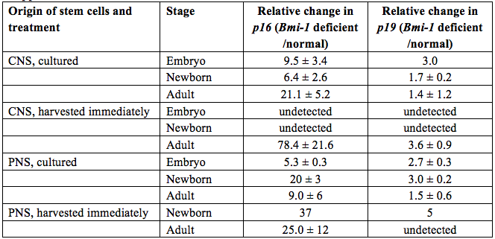
Table 14.5 Changes in p16^{Ink4a} and p19^{Arf} expression, as measured by amount of RNA transcripts, in CNS and PNS stem cells from Bmi-1 deficient mice relative to expression levels in normal mice. Sample sizes range from 1 to 6 experiments.
Table14.5
Notes:
Table 14.5 Changes in p16^{Ink4a} and p19^{Arf} expression, as measured by amount of RNA transcripts, in CNS and PNS stem cells from Bmi-1 deficient mice relative to expression levels in normal mice. Sample sizes range from 1 to 6 experiments. From Molofsky et al. 2003 Supplemental Table 1.

Slide 27
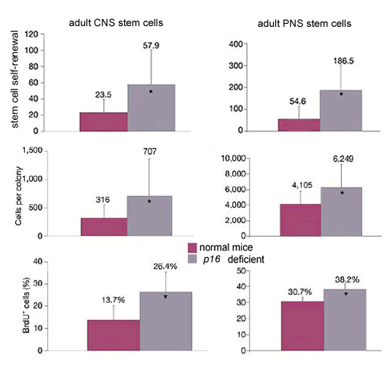
Figure 14.20
Notes:
Figure 14.20 Effects of loss of p16^{Ink4a} on stem cell colony proliferation and BrdU incorporation in adult CNS and PNS stem cells. CNS cells were cultured for 7 days and PNS cells for 10 days. Self-renewal was measured as the ratio of spherical stem cells to original isolated stem cells. * indicates that the p16^{Ink4a} deficient mouse stem cells had a statistically different response than stem cells from normal mice. Error bars are equal to 1 s.e.

Slide 28
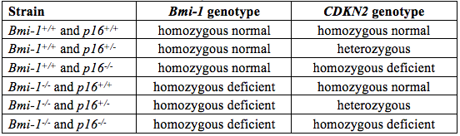
Table 14.6 Genetic make-up of mice used in experiments to test effects of Bmi-1 and CDKN2 genes on neural stem cells.
Table14.6
Notes:
Table 14.6 Genetic make-up of mice used in experiments to test effects of Bmi-1 and CDKN2 genes on neural stem cells. From Molofsky et al. 2003.

Slide 29
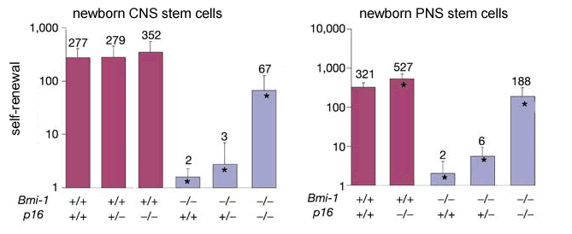
Figure 14.21
Notes:
Figure 14.21 Self-renewal of newborn mouse CNS and PNS stem cells in strains of mice with normal and non-functioning Bmi-1 and p16^{Ink4a} genes. The genotype of mouse strains is denoted by + (normal) or – (non-functioning). * indicates that self-renewal is statistically different from normal mice (+/+ for both genes).

Slide 30
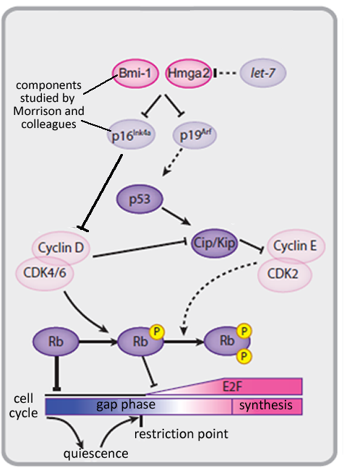
Figure 14.22
Notes:
Figure 14.22 Components of cell cycle regulation in tissue-specific stem cells in the absence of mitogen. More intensely shaded ovals indicate gene products that are functionally important while ovals with less intense color are less expressed or active. The bar at the bottom represents phases of the cell cycle, and the letter “P” denotes phosphorylation.

Slide 31
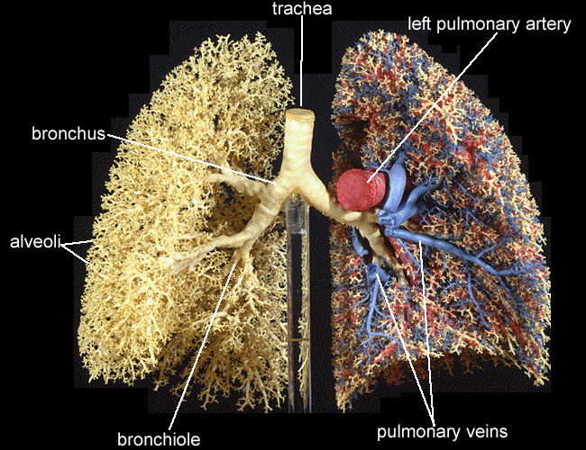
Figure 14.23
Notes:
Figure 14.23. Gross anatomy of the human lung, with blood vessels shown on the right (the left lung).

Slide 32
Figure 14.24
Notes:
Figure 14.24. Staining for antibodies of the p19^{Arf} protein in control cell lines in lung cancer study.

Slide 33
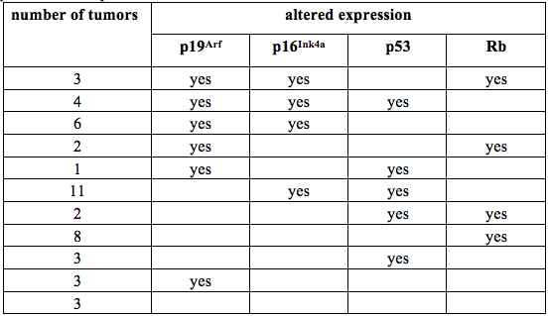
Table 14.7 Numbers of lung cancer tumors with abnormal expression of proteins involved in the cell cycle and self-renewal of stem cells. Altered expression is either downregulation or overexpression of the protein.
Table14.7
Notes:
Table 14.7 Numbers of lung cancer tumors with abnormal expression of proteins involved in the cell cycle and self-renewal of stem cells. Altered expression is either downregulation or overexpression of the protein. From Vonlanthen et al. 1998 Table 3.

Slide 34
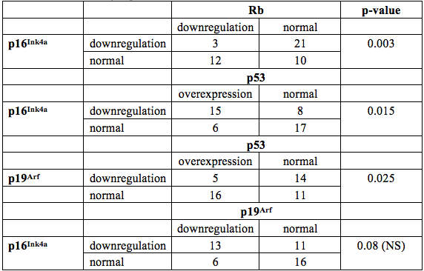
Table 14.8 Relationships among expression of some of the cell cycle proteins in lung cancer tumors. NS = not statistically significant.
Table14.8
Notes:
Table 14.8 Relationships among expression of some of the cell cycle proteins in lung cancer tumors. NS = not statistically significant. From Vonlanthen et al. 1998.

Slide 35
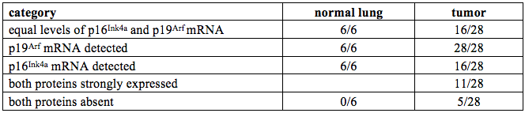
Table 14.9 Expression of p16^{Ink4a} and p19^{Arf} transcripts in normal lung tissue and lung cancer tumors.
Table14.9
Notes:
Table 14.9 Expression of p16^{Ink4a} and p19^{Arf} transcripts in normal lung tissue and lung cancer tumors. From Vonlanthen et al. 1998.

